Slide 1
Week-9 Architecture Patterns
Course Instructors:
HARIS AHMED
SIR SYED UNIVERSITY OF ENGINEERING & TECHNOLOGY

Slide 2
Agenda
WEB APP ARCHITECTURES: N-tier architectures
Architectural patterns
MVC
MVVM
MVP
VIPER

Slide 3
WEB APP ARCHITECTURES: N-tier architectures
Significance of “Tiers”
N-tier architectures have the same components
Presentation
Business/Logic
Data
N-tier architectures try to separate the components into different tiers/layers
Tier: physical separation
Layer: logical separation

Slide 4
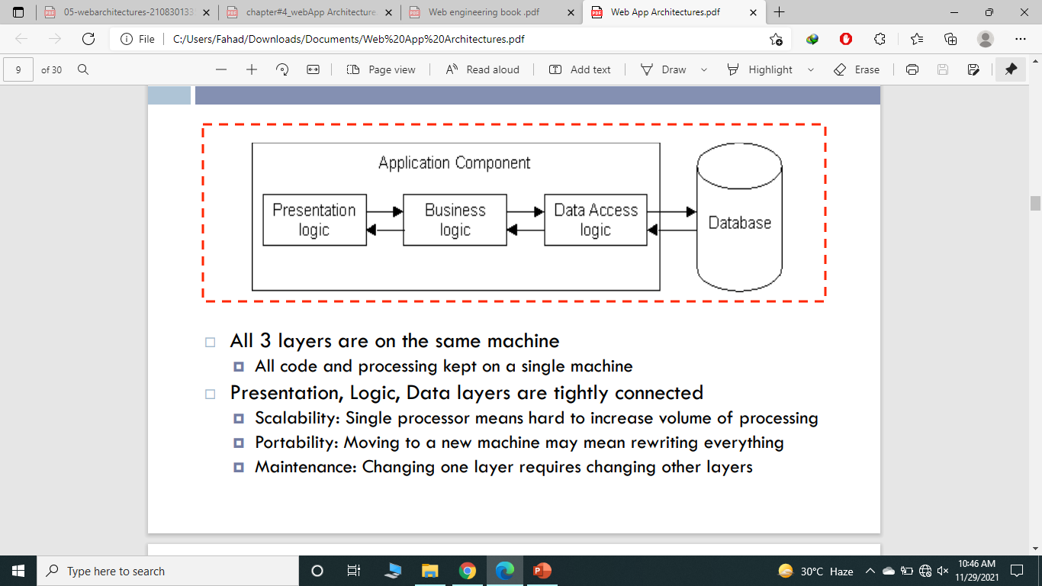
1-Tier Architecture
All 3 layers are on the same machine
All code and processing kept on a single machine
Presentation, Logic, Data layers are tightly connected
Scalability: Single processor means hard to increase volume of processing
Portability: Moving to a new machine may mean rewriting everything
Maintenance: Changing one layer requires changing other layers

Slide 5
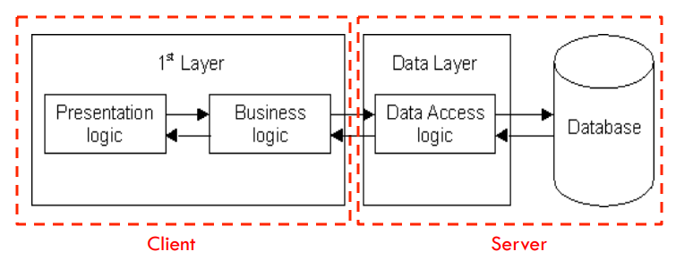
2-Tier Architecture
Database runs on Server
Separated from client
Easy to switch to a different database
Presentation and logic layers still tightly connected
Heavy load on server
Potential congestion on network
Presentation still tied to business logic

Slide 6
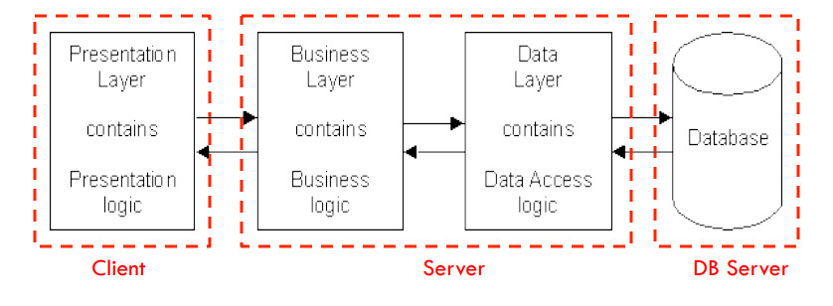
3-Tier Architecture
Each layer can potentially run on a different machine
Presentation, logic, data layers disconnected

Slide 7
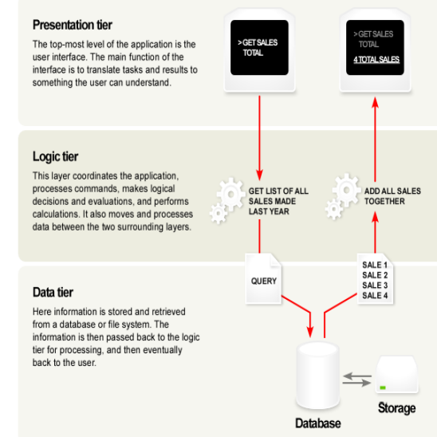
A Typical 3-tier Architecture
Architecture Principles
Client-server architecture
Each tier (Presentation, Logic, Data) should be independent and should not expose dependencies related to the implementation
Unconnected tiers should not communicate
Change in platform affects only the layer running on that particular platform

Slide 8
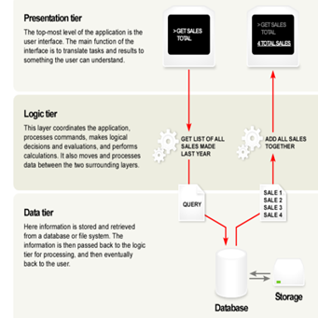
A Typical 3-tier Architecture: Presentation Layer
Presentation Layer
Provides user interface
Handles the interaction with the user
Sometimes called the GUI or client view or front-end
Should not contain business logic or data access code

Slide 9
A Typical 3-tier Architecture: logic Layer
Logic Layer
The set of rules for processing information
Can accommodate many users
Sometimes called middleware/back-end
Should not contain presentation or data access code

Slide 10
A Typical 3-tier Architecture: Data Layer
Data Layer
The physical storage layer for data persistence
Manages access to DB or file system
Sometimes called back-end
Should not contain presentation or business logic code

Slide 11
The 3-Tier Architecture: for Web Apps
Presentation Layer
Static or dynamically generated content rendered by the browser (front- end)
Logic Layer
A dynamic content processing and generation level application server, e.g., Java EE, ASP.NET, PHP, ColdFusion platform (middleware)
Data Layer
A database, comprising both data sets and the database management system or RDBMS software that manages and provides access to the data (back- end)

Slide 12
3-Tier Architecture - Advantages
Independence of Layers
Easier to maintain
Components are reusable
Faster development (division of work)
Web designer does presentation
Software engineer does logic
DB admin does data model

Slide 13
Architectural Patterns
What is the difference between MVC, MVVM, MVP, and VIPER?
Let’s take a look at each and determine for which cases they fit.

Slide 14
MVC (Model-view-controller)
MVC (model-view-controller) is considered one of the most popular in the mobile web app development.
What are the peculiarities? The MVC pattern allows creating simple cross platform app development and have plain navigation logic, uncomplicated content, mostly standardized UI app design, and a fairly straightforward user experience. It can easily and quickly implement tasks of the “loaded -> displayed” type.

Slide 15
MVC (Model-view-controller)
class Controller {
login() {
let email = document.getElementById('email').value;
alert("Done"); }
}

Slide 16
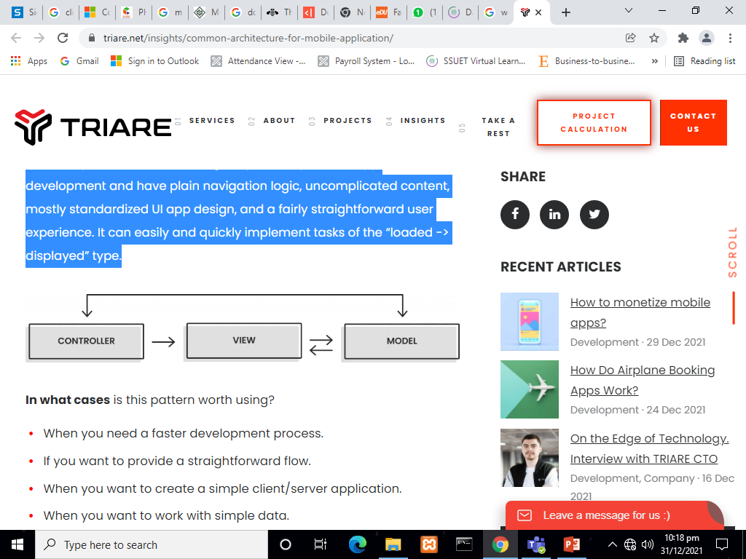
MVC contd…
Model - represent how data is stored in the database
View - the components that are visible to the user, such as an output or a GUI
Controller - the components that act as an interface between models and views

Slide 17
The MVC for Web Applications
Model
-Database tables (persistent data)
-Session information (current system state data)
-Rules governing transactions
View
-(X)HTML
-CSS style sheets
-Server-side templates
Controller
-Client-side scripting
-http request processing
-Business logic/preprocessing

Slide 18
Contd…
When to use?
When you need a faster development process.
If you want to provide a straightforward flow.
When you want to create a simple client/server application.
When you want to work with simple data.
If you need unformatted data results.
When you want to create an SEO friendly platform.
When there is a unidirectional flow of instructions on a screen.

Slide 19
MVVM (model-view-view-model)
The second most frequently used pattern is MVVM (model-view-view-model).
What are the peculiarities? Unlike the previous pattern, this one allows you to separate UI logic from business logic.
That makes it possible to implement more complex functional tasks and give the user a wider choice of actions and interactions with the mobile application. One advantage is the convenience of implementing auto tests since the tested business logic is separated from the UI implementation.
When to use? This pattern is more universal and suitable for writing more complex applications. MVVM is a good choice when developing small projects with the prospect of a slight expansion of functionality.

Slide 20
MVVM (model-view-view-model)
// MVVM Example
class ViewModel {
message = ""; //
updateMessage() {
this.message = "Hello";
}
}

Slide 21
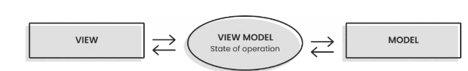
Contd…
MODEL: ( Reusable Code – DATA ) Business Objects that encapsulate data and behavior of application domain, Simply holds the data. VIEW: ( Platform Specific Code – USER INTERFACE ) What the user sees, The Formatted data. VIEWMODEL: ( Reusable Code – LOGIC ) Link between Model and View OR It Retrieves data from Model and exposes it to the View. This is the model specifically designed for the View.

Slide 22
MVP (model-view-presenter)
MVP (model-view-presenter) pattern is parallel in use to the MVC pattern.
What are the peculiarities? The choice of use between these two patterns depends on the load on user interaction with the application UI and the difference in data display. The testability of data in MVP is limited to models and views.
In what cases to use? This pattern should be used if you have a limited set of UI components and a simple flow of navigation in the application.

Slide 23
MVP (model-view-presenter)
class Presenter {
login(email) {
view.showMessage("Done");
}
}

Slide 24
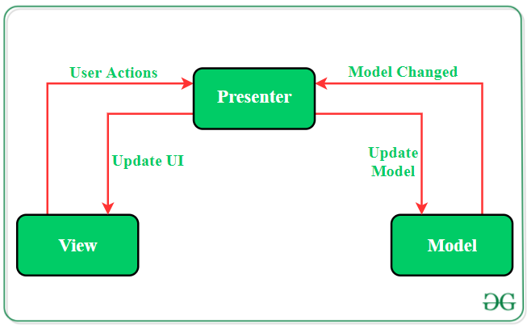
Contd…
Model: Layer for storing data. It is responsible for handling the domain logic(real-world business rules) and communication with the database and network layers.
View: UI(User Interface) layer. It provides the visualization of the data and keep a track of the user’s action in order to notify the Presenter.
Presenter: Fetch the data from the model and applies the UI logic to decide what to display. It manages the state of the View and takes actions according to the user’s input notification from the View.

Slide 25
VIPER (View, Interactor, Presenter, Entity, and Router Model)
VIPER is a pattern used to implement long-term projects. Though it is a modular architecture, developing applications on it requires a long launch.
What are the peculiarities? VIPER supports clean code ideas. It requires deep knowledge and understanding of the field of programming. This architecture pattern provides good test coverage, isolation of the new functionality implementation, and dependency of areas of responsibility. A project with this architecture requires 2 or more developers to build cross platform mobile apps.
When to use? This architecture should be used for long-term projects that have explicit technical requirements.

Slide 26
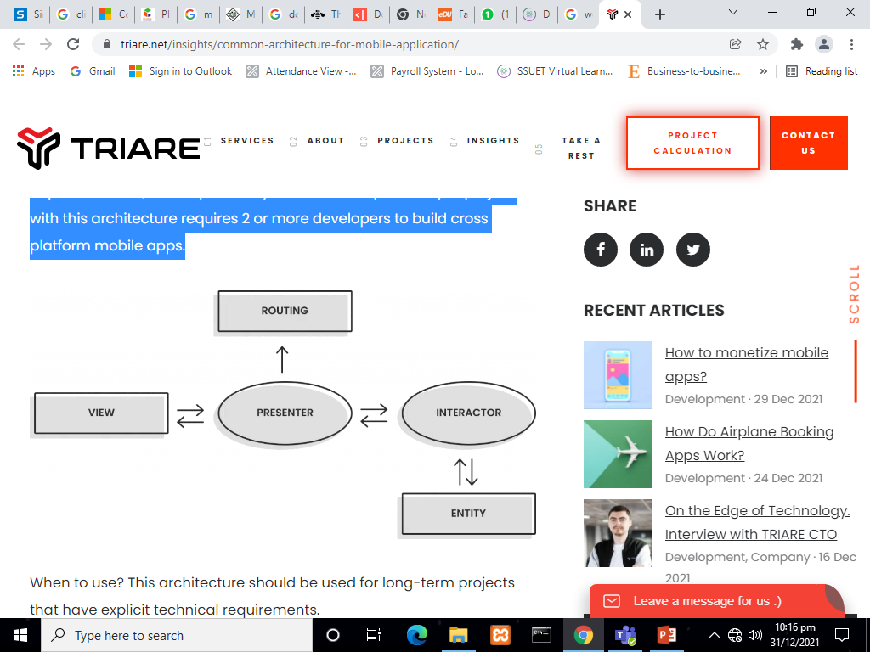
Contd…
View: is the user interface.
Interactor: is a class that mediates between the presenter and the data. It takes direction from the presenter.
Presenter: is the “traffic cop” of the architecture, directing data between the view and interactor, taking user actions and calling to router to move the user between views.
Entity: represents application data.
Router: handles navigation between screens.

Slide 27
Conclusion
We have discussed 4 main architecture types used in the web application development. They have different things to offer.
If you need a simple application with plain navigation, content, and UI, then MVC is probably the right choice. If the project is small but more complex, with prospects of slight expansion, you should think of MVVM or MVC . The choice between those two depends on the load on UI and data display. VIPER is best for large, long-term projects and custom app development.

